Slide 1


Es.Next LectuRe 2
National Telecommunication Institute
Ministry of Communications and Information Technology

Slide 2
Agenda
Promises
oop ES6
ES6 Modules
Set
Map

Slide 3
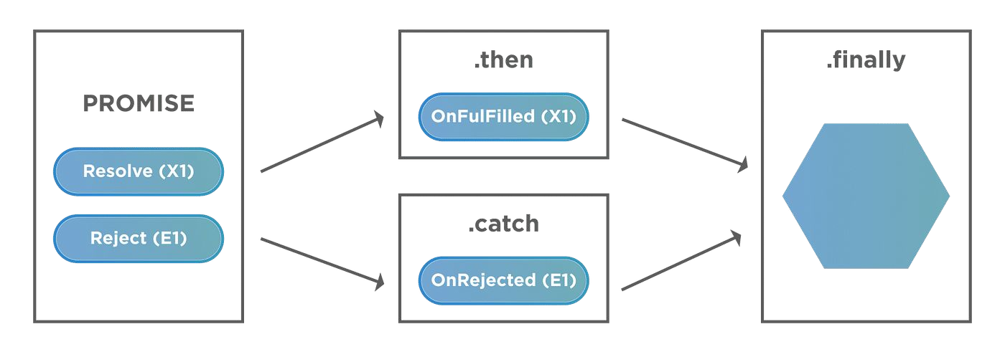
PRomises
The Promise object represents the eventual completion (or failure) of an asynchronous operation and its resulting value.
It’s object that is used as a placeholder for the future result of an asynchronous operation
We can chain promises instead of nesting callbacks

Slide 4
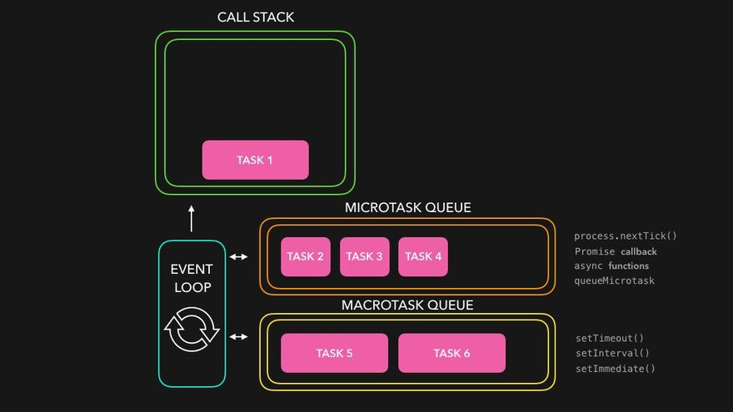
PRomises
We can handle promises using :
Then , catch
Or
Async , await

Slide 5
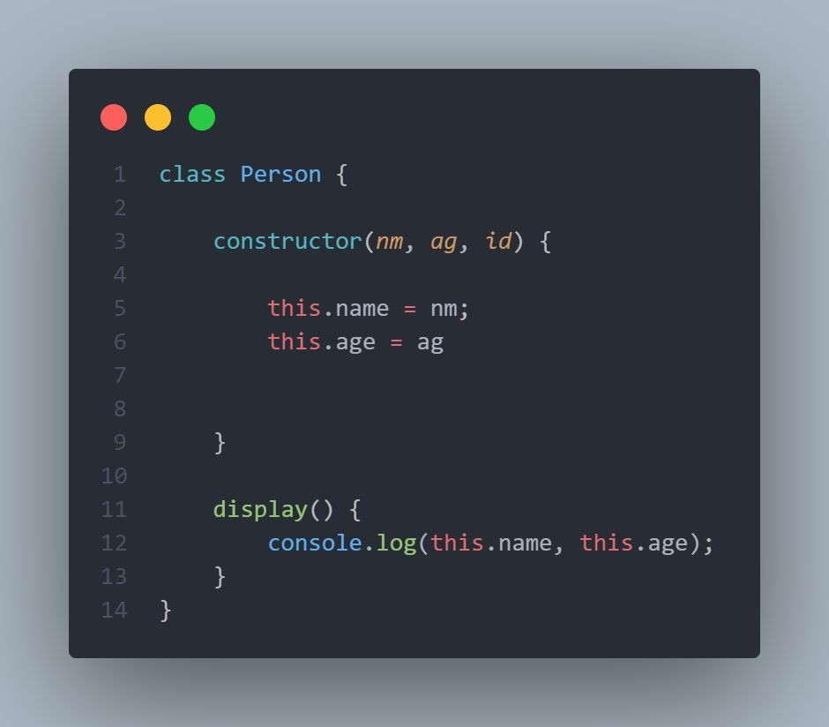
Classes in ES6
Classes are in fact "special function", and just as you can define function expressions and function declarations, a class can be defined in two ways: a class expression or a class declaration.

Slide 6
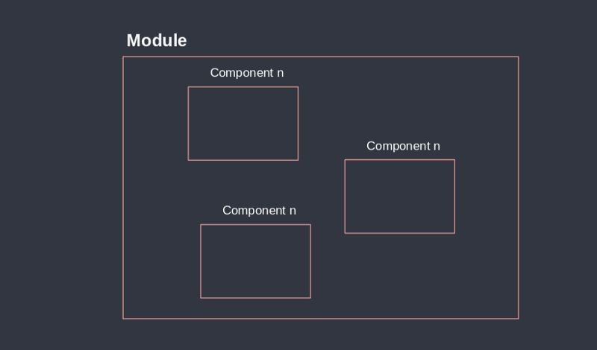
Modules

Slide 7

Set
The Set object lets you store unique values of any type, whether primitives values or object references.

Slide 8
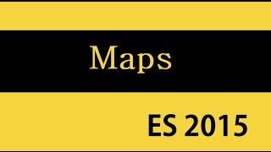
Map
The Map object holds key-value pairs and remembers the original insertion order of the keys. Any value (both objects and primitive values ) may be used as either a key or a value.

Slide 9
Thank you

